Slide 1
LENAWEE COMMUNITY MENTAL HEALTH AUTHORITY ANNUAL REPORT 2022
Board of Directors
Judy Ackley – Vice Chair
Amy Palmer – Chair
Commissioner Jim Goetz
Tim Kelly
Deidre Reed – Secretary
Nate Smith
Holly Terrill
Commissioner Ralph Tillotson
Nic Wilson
Erin Starlin
Nancy Eaton Gordon
To Promote Positive Outcomes by Creating a Path to Resilience, Recovery, Wellness and
Self-Determination

Slide 2
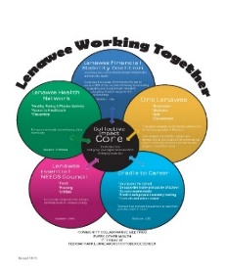
INVESTED IN PREVENTION
LCMHA facilitates the Lenawee Substance Abuse Prevention Coalition: a diverse and extensive cross section of agencies/organizations and individuals who are committed to issues facing Lenawee, particularly the opioid crisis. Initiatives include improving access to medication assisted treatment; education; building relationships with law enforcement and the jail; providing support wherever possible.
COMMUNITY PARTNERS
Community Mental Health acts as the backbone organization of the Collective Impact Core – which includes representatives of each of the Collective Impact groups in Lenawee County. There are currently five different groups using the Collective Impact Model:
Lenawee Essential Needs Council (food, housing, and transportation)
OneLenawee (making and keeping Lenawee a great place to live)
Lenawee Health Network (improving the quality of health in Lenawee)
Lenawee Financial Stability Coalition (expanding budgeting and saving through education and skill building)
Lenawee Cradle to Career (maximize educational opportunities)
Trauma-informed care and resilience have been identified as common issues affecting the work of all of our Collective Impact Workgroups and has become the focus of our work. Collectively, we are working to increase awareness, education and resilience for the greater community. The Collective Impact Core also sets the agenda for monthly Human Service Collaborative Meetings- these are open to anyone in the community to attend. The Collaborative meets to share information, provide CI group, agency and other coalition updates ,and provide an opportunity for networking.

Slide 3
COMMUNITY OUTREACH
LCMHA continues to reach out to the community to listen to their concerns, provide education and community enrichment in order to break down the barriers for persons with behavioral health conditions.
In 2022 we participated in:
Project Connect | Seeking Safety Group | Engagement Groups
E-Race Stigma 5K Run, Walk & Kids Dash | Victims Service Unit & Steering Committee | State Walk a Mile Rally
Lenawee County Community Crisis Team | Domestic Violence Task Force | Comstock Christmas Tree Program
Day of H.O.P.E. Adult Mental Health First Aid | Lenawee Treatment Courts Drug Take Back Day | Consumer Action Committee Naloxone training and distribution
Lenawee Substance Abuse Prevention Coalition Basic Motivational Interviewing Advanced Motivational Interviewing | Hunger Free Lenawee Lenawee Emergency Operations Committee Lenawee CISM Team | Regional Consumer Advisory Committee Lenawee Transportation Corporation Board
HRSA Rural Communities Opioid Response Program | Continuum of Care | Lenawee Human Services Collaborative
Continuum of Care – Point in Time Count | SMART Recovery Support Groups | Parent Management Training – Oregon Model (PMTO)
Lenawee Financial Stability Coalition | Cradle to Career | Collective Impact Core
Lenawee Health Network | Great Start Collaborative | Head Start Policy Council
Lenawee Essential Needs Council | OneLenawee Enhancing Consumer Voice Committee | City of Adrian Human Relations Commission
Wraparound Gatekeeping Transportation Task Force | Wraparound Community Team Lenawee County Veteran’s Coalition | Early Head Start Inter-Connections Liaison
Regional Gambling Disorder Prevention Work Group State Customer Service Committee | Lenawee Emergency Preparedness Group Share the Warmth Building Safe & Healthy Communities | Greater Lenawee Tobacco Reduction Coalition State Suicide Prevention Committee State CMH PR Committee
Notes:
Updated

Slide 4
REVENUE
FINANCIAL STEWARDSHIP
EXPENSES
Notes:
updated

Slide 5
OPERATIONS EFFICIENCY
COMMUNITY INPATIENT UTILIZATION
 | FY21 | FY22
Admissions | 287 | 365
Inpatient Days | 2363 | 2582
Average length of stay (days) | 8.23 | 7.07
Notes:
NEEDS UPDATING

Slide 6
OPERATIONS EFFICIENCY
All individuals in need of mental health services, regardless of urgency, can access services at LCMHA by walking into our offices or by calling 517.263.8905 or 1.800.644.5005.
It is the mission of the Access Center of LCMHA to arrange for effective, medically necessary mental health and substance use services for residents of Lenawee County. The Access Center is the single entry point in Lenawee County for individuals, their families and community partners who seek services from the public mental health and substance use system, including medical professionals, hospitals, law enforcement, schools and other providers. We serve individuals and families with several benefit packages: Medicaid, Healthy Michigan, and individuals with no resources are served with General Fund monies from the State of Michigan.
Emergency Services:
We participate on the Lenawee Sheriff’s Dept., Victims Service Unit, which is a team of emergency responders who have been trained by state and local law enforcement to provide immediate, on-site assistance to families dealing with the aftermath of a crisis. Response teams accompany emergency personnel to the scene, to provide support and assistance to survivors, helping to connect them with the services they may need.
LCMHA has accepted the responsibility of being Lenawee County’s 24 hour Community Crisis Response contact agency. The Lenawee County Community Crisis Team provides crisis management, debriefing, defusing, and follow up services for traumatic events such as: accidents, abuse, bomb threats, deaths, suicides, fire, natural disasters, terrorism events, etc.
The LCMHA continuum of care includes immediate 24 hours, 7 days per week emergency and urgent care for all of the current consumers, potential consumers, and all residents of the state of Michigan.
Information about LCMHA can be found on our website: www.lcmha.org. We also have a Facebook page.

Slide 7
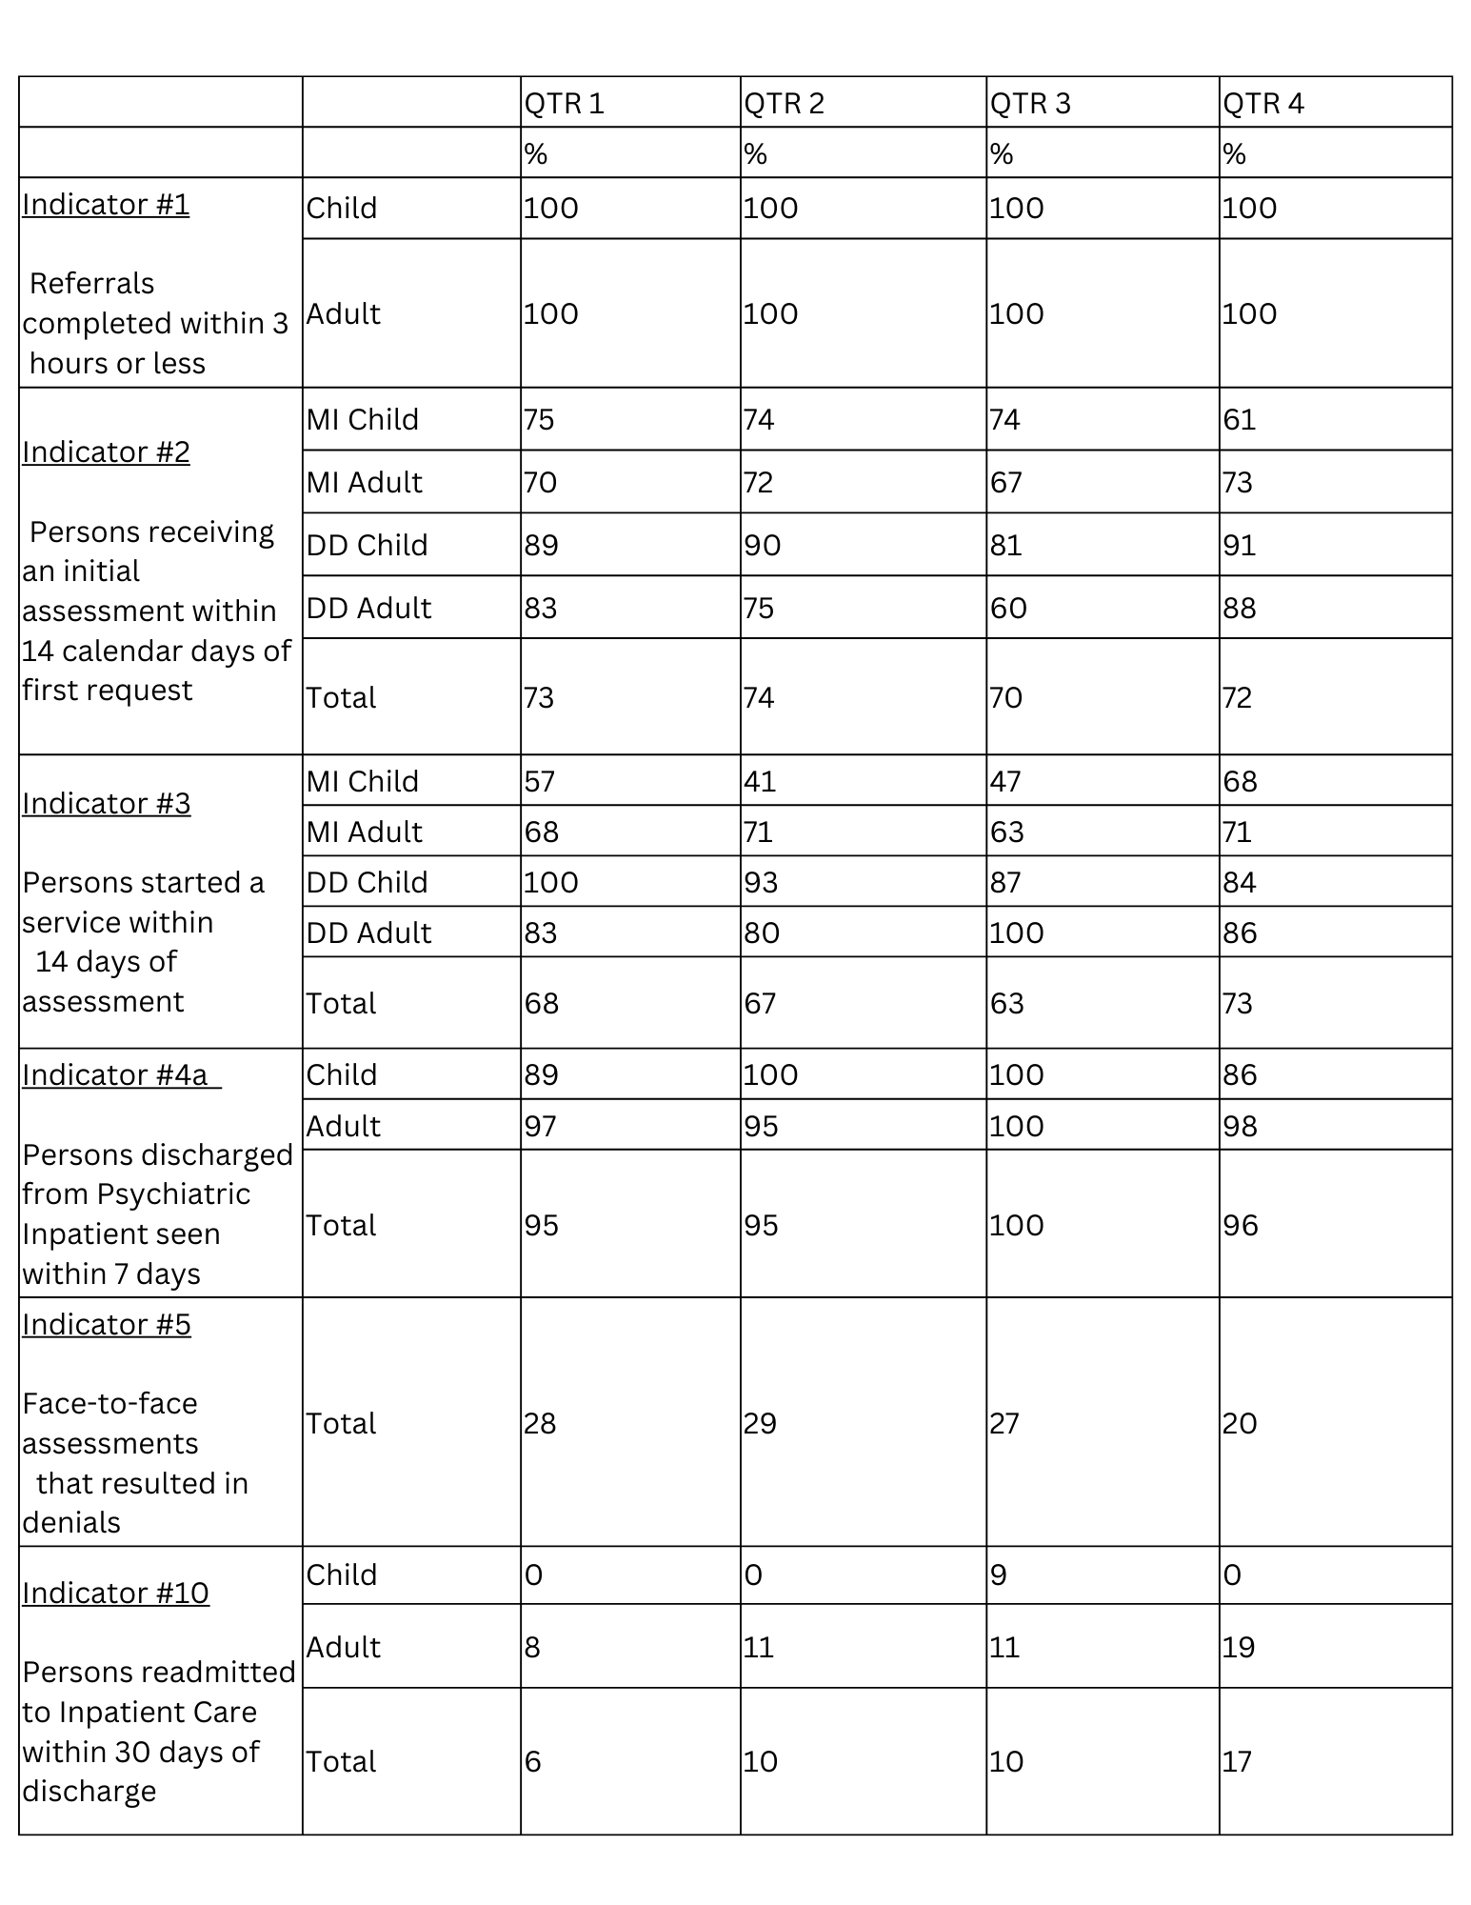
OPERATIONS EFFICIENCY
MDHHS DATA YEAR END REPORT 2022

Slide 8
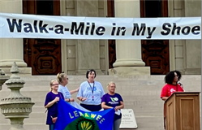
CONSUMER SATISFACTION THROUGH
ADVOCACY; AWARENESS AND ANTI-STIGMA
Consumer Action Committee is focused on educating the community about mental illness; promoting self sufficiency, and educating consumers on current and pending legislation. Members of Consumer Action Committee are active on many community groups, and act as the consumer voice at LCMHA board meetings.
In September, eleven of our consumers and staff traveled to the Capital Building in Lansing to attended the annual Walk A Mile in My Shoes Rally. The event is held to enhance public awareness, and educate legislators on mental health, end stigma, and promote mental health and wellness.
Projects the Consumer Action Committee participated in and/or organized in 2022 included:
Greg Adams E-Race the Stigma 5K Run/Walk & Kids Dash
Mental Health Awareness Lansing Walk a Mile Rally
Day of HOPE
Celebration of Success
Attended Regional Meetings
Continues to be the voice of the people we serve by representation on:
Lenawee Substance Abuse Prevention Coalition
Regional Consumer Advisory
Notes:
NEEDS UPDATING

Slide 9
CONSUMER SATISFACTION
THROUGH SUPPORT AND RECOVERY
In
Interconnections Inc. Drop in Center is a safe place for people who have experienced a mental illness or substance use disorder with a mental illness sometime in their life. This is a 501.c3 (non-profit) organization completely staffed by persons who have had, or are in recovery from, a mental health disorder. The Board of Directors are persons who have personal knowledge of mental health disorders. All staff are certified peer support specialists, certified by the State of Michigan and the Center is a member of the Michigan Drop in Centers through JIMHO (Justice In Mental Health Org). Anyone in the community over the age of 18 years is welcomed at the Center and there is never a charge for any of their services. Services include, but are not limited to, exercise groups; smoking cessation support groups, bipolar/depression support groups; diabetes and chronic pain management classes; cooking classes, linking with community resources as well as one on one support from staff. The center is open daily from noon to 6pm.
Pathways Engagement Center provides a warm, welcoming and safe environment for persons seeking help with substance use issues. Pathways is a place a person can gain immediate access to resources, support, advocacy and referrals at a time and place that is not generally available or open to persons looking for help. Pathways is staffed with Peer Recovery Coaches who are in long term recovery themselves. It is open 8pm – 8am Monday through Thursday, and Friday 8pm through Monday 8am. While it is not a shelter (we do not have beds), individuals may stay at the center for up to 23 consecutive hours. Smart Recovery Groups are held twice daily and more often on weekends.
LCMHA has several levels of Peers working throughout our service spectrum. A Peer is someone who has, sometime in their life, received services for the same issues of those they are working with. We have a Parent Support Partner who knows what a parent goes through with their child who is receiving services. The Parent Support Partner helps empower the parent(s) through education and resources. They can help parents prepare for upcoming IEP’s, school meetings and doctors appointments. A Youth Peer Support Specialist can relate to the youth receiving services by sharing their own experience and helping the youth determine the right path for them. The Youth Peer can be someone the youth relies on to help him/her understand what is going on.
Notes:
Partially updates

Slide 10
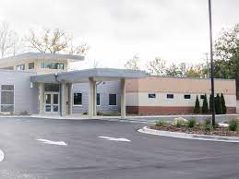
HEALTH INTEGRATION
The Family Medical Center at 1200 N. Main, Adrian, MI 49221 co-locates LCMHA Psychiatrists, nursing and reception staff, Integrated Health Supervisor, Integrated Health Care Manager and Outpatient Therapists in a medical building that houses primary care physicians, dentists, DHHS office, lab services, physical therapy, pharmacy and behavioral health.
This is a one-stop shop for many of our consumers who previously did not have a primary care physician. FMC staff are actively working with LCMHA to continue to increase integration by being active members on committees and workgroups. LCMHA has strengthened referrals to the community with “warm transfers”, increased coordination with consumers, primary care providers and assists with discharge orders from the ER or hospital stays. FMC has a medication assisted treatment program to support those that are interested in recovery from substance use.
LCMHA has initiated a new Behavioral Health Home called Health Hub, which is focused on supporting consumers by reaching their physical health goals, and reducing Emergency Room and Hospitalizations by being supported by a team of Nurses, Medical Assistants and Peers. Health Hub monitors health data, coordinates with Primary Care providers. The Health Hub team has one on one contacts to help educate and motivate the consumer with health improvement such as weight loss, quitting smoking, attending appointments and following Doctor orders, or starting an exercise regimen.
LCMHA is utilizing Medicaid claims data to recognize high utilizers of the hospital emergency rooms and offers physical and behavioral supports to decrease those numbers. Data is also used for case consultation to support CMH staff along with monthly collaboration with each Medicaid HMO Plan in our county.

Slide 11
ORGANIZATIONAL CAPACITY EMPLOYEE COMPETENCIES
STANDING COMMITTEES | EMPLOYEE TRAININGS
Health & Safety Behavior Treatment Review Committee Sentinel Event Review Utilization Management & Review Culture Crew Diversity, Equity, & Inclusion SUD Providers An inclusive environment that meets the needs of the people in it Access to the full spectrum of resources available to us Clear and meaningful processes A safe and stigma-free community | CMHAM Conferences | ABA
 | safeTALK Training | LOCUS
 | Mental Health First Aid Adult/Youth | Infant Mental Health Gentle Teaching
 | Motivational Interviewing | NARCAN
 | Yellow Ribbon | BHTEDS
 | Parent Management Training-Oregon Model (PMTO) | Columbia Suicide Risk Assessment
 | Parenting Through Change (PTC-R) | Child Abuse Mandatory Reporting
 | Integrated Healthcare Training | Confidentiality/HIPAA/ Boundaries
 | Trauma Focused Therapy Training | Recipient Rights EMDR
 | DBT CPR | Due Process Grievance & Appeals
 | Ethics Advanced Directives Psychiatric Advance Directives | Person Centered Planning HIPAA & Boundaries
 | CAFAS/PECFAS | Health & Safety
 | Cultural Competency | Limited English Proficiency
 | Customer Service | Corporate Compliance & Medicaid Integrity
PERFORMANCE IMPROVEMENT PROJECTS
STRATEGIC PRIORITIES

Slide 12
ORGANIZATIONAL CAPACITY
As a public entity, LCMHA realizes its responsibility to be accountable to the community for what we do and how we do it. We are always working to assure that we are providing the right services to the right people at the right time. We work to assure that those we serve are treated with respect. And, we work to manage our operations using financially sound strategies. With these goals in mind, below are some of the accountability measures we employ across our system to assure the highest standards of accountability:
LCMHA is accredited by the Joint Commission.
LCMHA is Certified by MDHHS; and is a member of CMHAM (Community Mental Health Association of Michigan).
Financial & Compliance Audit: LCMHA contracts with an independent accounting firm – Roslund Prestage & Co, who audit in accordance with Government Auditing Standards.
The Office of Recipient Rights: Rights protection is provided by LCMHA. Potential rights violations, medication errors and other potential risks to consumers are identified, investigated and remedied effectively and in a timely manner. If you have questions about your rights, call the ORR, 517-263-8905 or 734-544-3000.

