Slide 1
WELCOME TO:
LENAWEE
COMMUNITY MENTAL HEALTH
AUTHORITY

Slide 2
MISSION STATEMENT
"Promoting Positive Outcomes
through Quality Mental Health Services."

Slide 3
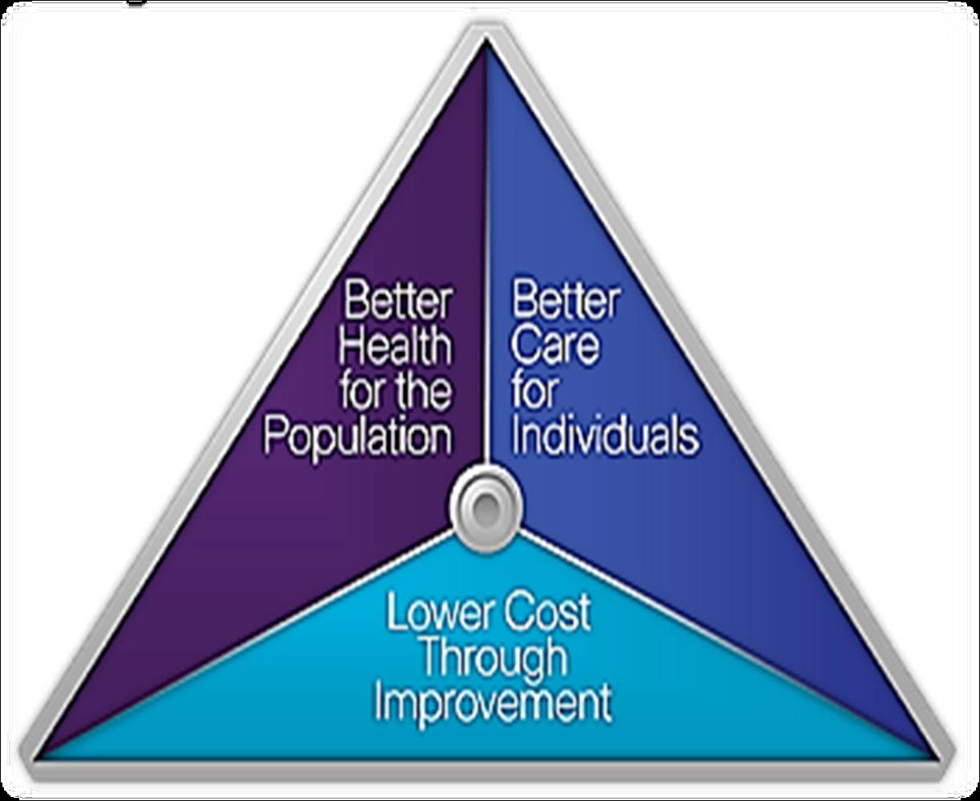
INTEGRATED HEALTH
THE BEST APPROACH FOR EVERYONE

Slide 6
LCMHA is a member of The Community Mental Health Partnership of Southeastern Michigan
Along with Livingston, Monroe and Washtenaw County
This partnership strives to be the model of excellence in a regional system of integrated care, joining with consumers, families and the community to help consumers reach their dreams

Slide 8
ACCREDITATION
LCMHA is accredited by The Joint Commission of Healthcare Organizations
If someone you know has an issue with their services or feels unsafe:
Contact Customer Services
263.8905

Slide 10
YOUR RIGHTS
All consumers of Lenawee Community Mental Health will be treated fairly and with dignity and respect.
If this is not happening, contact
The Recipient Rights Officer –Katie Snay
ask for a Recipient Rights Complaint Form
ask for Customer Services

Slide 11
ROSC – Recovery Oriented System of Care
Recovery Oriented Systems of Care support person centered and self-directed approaches to care that build on the strengths and resilience of individuals, families and communities to take responsibility for their sustained health, wellness, and recovery from alcohol and drug problems. For more info ask to speak to customer services.

Slide 13
NEED HELP…
Do you know someone who could benefit from substance abuse help? Treatment is available. Have them contact CMH for information on what is available in our community.

Slide 14
WHAT IS CUSTOMER SERVICES?
A link between you, the CMH System and the community
Seeks to reduce stigma about disabilities by educating the public
Wants you to be satisfied with the services you receive
Answers any questions you may have about mental health issues

Slide 16
CONTACT US
Lenawee Community Mental Health Authority
1040 S. Winter Street, Suite 1022
Adrian, MI 49221
Phone: (517) 263-8905
Toll Free: (800) 664-5005
Hours: Mon. thru Fri. 8:30 a.m. – 5:00 p.m.
Evening hours by appointment

Slide 18
HELP REDUCE STIGMA
Become a member of the:
MENTAL HEALTH AWARENESS COMMITTEE
Help organize conferences/workshops
Arrange programs for the community
Learn how to be a leader, to express your thoughts
Call Customer Services at 263-8905

Slide 19
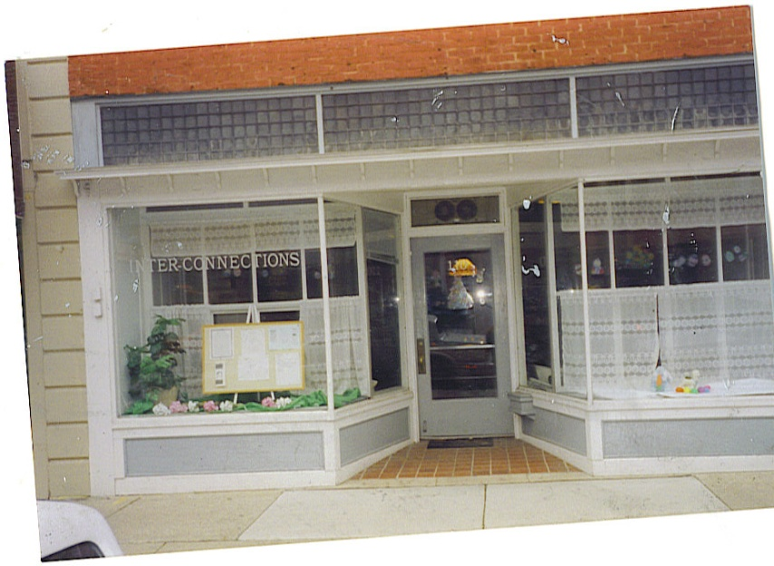
INTERCONNECTIONS DROP IN CENTER
A place where persons with mental illness can come together to connect with each other in a social setting
110 W. Maumee Street
Adrian, MI 49221
517.265.9588
HOURS
Closed Sundays & Mondays
Tues, Wed, Thurs 12 – 5pm
Fri – Sat 12pm – 8pm
www.lcmha.org – go to InterConnections

Slide 21
Health Kick
Do you feel you are not getting enough exercise? Having trouble keeping a healthy lifestyle? Join Inter-Connections Healthy Living Initiative. Call 265-9588 or stop by the Drop In.

Slide 23
PEER SUPPORT SPECIALISTS
A Certified Peer Support Specialist is a person in recovery who is certified to help people on their journey of recovery
What can a Peer Support Specialist do?
Answer benefit/service questions
Give you info about community resources
Be a listening ear when one is needed
If you would like to talk with a Certified Peer Support Specialist, call 517.263.8905

Slide 24
LENAWEE PEER SPECIALISTS
Brenda Lawson – LCMHA (263.8905)
Ni Gordon – LCMHA (263.8905)
Mark Roman – Inter-Connections (265.9588)
Jennifer Durell - Inter-Connections (265.9588)
Todd Bowen - Inter-Connections (265.9588)
Michael Warfield – LCMHA (263.8905)

Slide 26
COMMUNITY RESOURCES
Are you in need of housing?
Do you know of someone who needs help with their utilities?
Do you need other information?
Ask Customer Services for a list of resources

Slide 27
NO PRIMARY CARE DOCTOR?
OR NO INSURANCE?
Contact:
The Family Medical Center
225 Riverside Avenue, Adrian, MI 49221
517.263.1800

Slide 28
NO PRESCRIPTION DRUG COVERAGE?
Ask the nurse about the Patient Assistance Program
Or
Customer Services for the
FAMILYWIZE discount prescription card

Slide 29
Half way there

Slide 30
SUICIDE PREVENTION
Thoughts of Suicide?
Crisis hotlines are available at:
1-800-273-8255
or
1-800-784-2433

Slide 32
`
Been There…Done That

Slide 33
HELPLINE ESPANOL
¿No te alcanza el dinero para comprar comida para ti y tu familia?
…no te preocupes
Llámanos a la Línea de Ayuda para el Programa de Alimentos y Nutrición
1-800- 481-4989 www.foodstamphelp.org
Te diremos si calificas para recibir una Tarjeta de Asistencia de Comida o Bridge Card.
Nuestros servicios son gratis, la llamada es confidencial y puede ser en Español o Ingles.
Michigan State University (MSUE) trabaja con la Línea de Ayuda para darte información de cómo:
Comprar más alimentos con menos dinero.
Preparar comidas fáciles y saludables para ti y tu familia.

Slide 34
HELPLINE
Is your plate empty?
Call the Food and Nutrition Helpline at
1-800-481-4989
M-F 9am-5pm
www.foodstamphelp.org

Slide 35
DEPRESSION SUPPORT GROUP
Depression Support Group
Wednesday 2:00pm – 3:00pm
Interconnections Drop In Center
110 W. Maumee St, Adrian
No Cost
Call: 265.9588 for more info

Slide 36
MOTIVATIONAL INTERVIEWING
Mark Lowis, LMSW
October 28th & 29th from 8am – 4pm
Human Service Building, 1040 S. Winter St, Adrian, MI–River Raisin/Spartan Rooms
Lunch and refreshments provided
Enhance awareness, learn to listen and guide, while remaining respectful, empathetic, affirming and supportive.
MCBAP CE Hours approved
Social Work CEU’s available

Slide 37
RECOVERY COACH TRAINING
SEPTEMBER 23 – 27, 2013
WEBER RETREAT & CONFERENCE CENTER
1257 East Siena Heights Drive, Adrian 9am – 5:00pm
To register – contact: Stephannie Weary at wearys@ewashtenaw.org 734-222-3806
Or Justin Williams at 734-845-2944

Slide 38
safeTALK TRAINING
Prepares anyone over the age of 15 to identify persons with thoughts of suicide and connect them to suicide first aid resources.
THURSDAY, SEPTEMBER 19, 2013
1:30PM (Registration)
RIVER RAISIN & SPARTAN ROOMS, HUMAN SERVICES BUILDING
Light refreshments will be provided
RSVP – KAREN RAWLINGS, 517-264-0105 OR krawlings@lcmha.org

Slide 40
DBSA SUPPORT GROUP
Depression and Bi-Polar Alliance (DBSA)
Thursday 3:00 – 4:00 pm
Inter-Connections Drop In Center
110 W. Maumee Adrian, MI 49221
No Cost
Call 265-9588 for more info.

Slide 41
SCHIZOPHRENIA ANONYMOUS
Schizophrenia Anonymous (SA)
Wednesday 3:00 – 4:00 pm
Inter-Connections Drop In Center
110 W. Maumee, Adrian, MI 49221
No Cost
Call 265-9588 for more info.

Slide 42
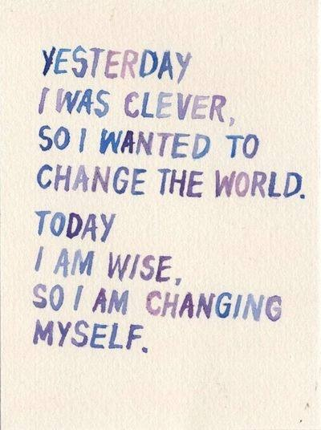

Slide 43
PROGRAMS FOR HOMELESS
Homeless Assistance Recovery Program (HARP):
Section 8 vouchers for homeless families and individuals
To apply call 265-6776 Kelli Kamm
Tenant Based Rental Assistance (TBRA):
A program to provide housing for young families
To apply call 264-0782 or go to LEAHC

Slide 44
2-1-1
Dial 2-1-1 on your phone to get all the human services information for Lenawee County
This is a program brought to you by Lenawee United Way

Slide 45
Lcmha newsletter
“THE GRAPEVINE”
Contains all kinds of news;
articles and useful information
Advise Customer Services if you would like to receive a copy

Slide 46
Mindful Eating Group
Every Friday 2:30—3:30 pm, starting November 30th we will meet to talk about eating healthy. Join us for our first 6 week session as we help each other become
healthier through good eating habits. We will also have monthly Healthy cooking classes
Located at Drop-In Center 265-9588

Slide 47
Smoking Cessation Support Group
Starting 12/4/12
Meets every Tuesday
11 am—12 pm
Located at Drop-In Center 265-9588

Slide 48
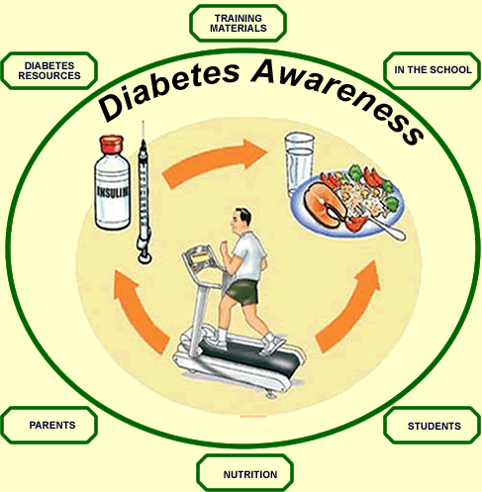
Diabetes Support Group
Starting 11/29/12
Meets every Thursday
1:30—2:30 pm
Located at Drop-In Center 265-9588

Slide 50
LENAWEE COMMUNITY MENTAL HEALTH AUTHORITY ANNUAL REPORT 2012
Board of Directors
Judy Ackley – Chairperson
Deb Bills – Vice Chair
Scott Clites – Secretary
Mark Jackson
Howard Keller
Emily Martinez
Grace Miley
Nate Smith
Comm. Cletus Smith
Jim Van Doren
Comm. Don Welch
Bob Wilson
Ask customer service for a copy

Slide 51
www.lcmha.org
All the information contained in this presentation is available from Customer Services or our website www.lcmha.org

Slide 52
“To effectively communicate, we must realize that we are all different in the way we perceive the world and use this understanding as a guide to our communication with others.”
–Anthony Robbins

Slide 54
Designed By:
Monitor Created by – Karen Rawlings
Monitor Updated by:
Tony Louden A.K.A.
Dudeonwheels
Tony “dudeonwheels” Louden
DON’T LET YOUR DISABILITY
DEFINE WHO YOU ARE

