Slide 1
WELCOME TO:
LENAWEE
COMMUNITY MENTAL HEALTH
AUTHORITY

Slide 2
MISSION STATEMENT
“To promote positive outcomes by creating a path to Resilience, Recovery, Wellness and Self-determination."

Slide 3
Values

Slide 4
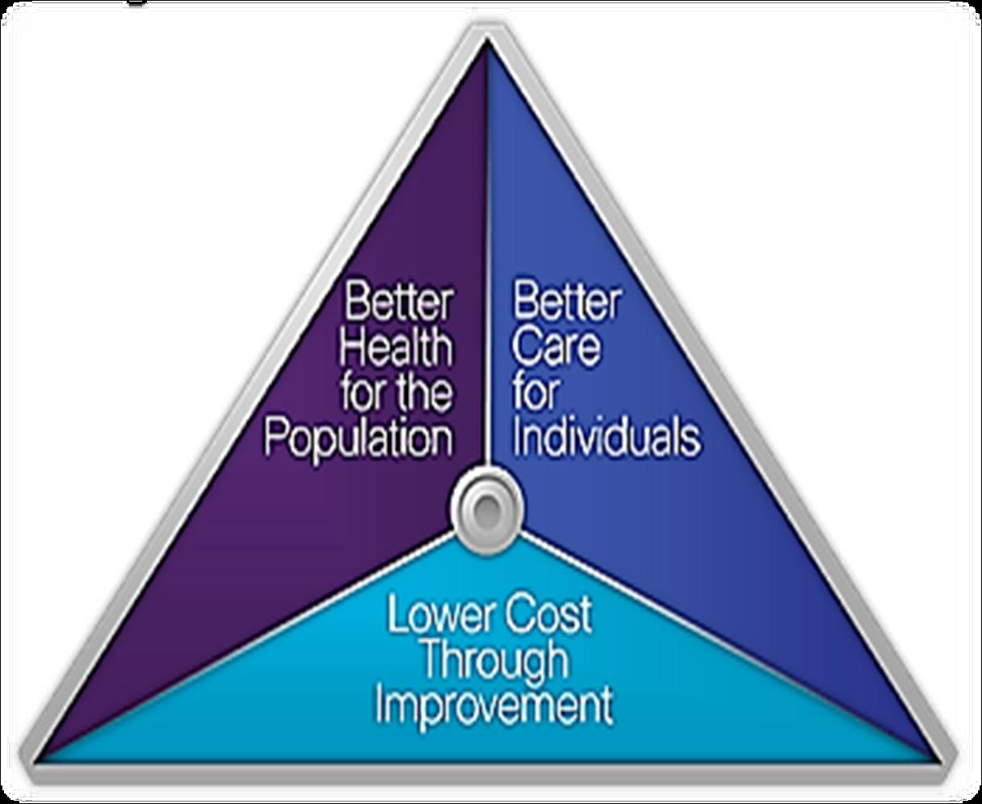
INTEGRATED HEALTH
THE BEST APPROACH FOR EVERYONE

Slide 5
LCMHA is a member of The Community Mental Health Partnership of Southeastern Michigan
Along with Livingston, Monroe and Washtenaw County
This partnership strives to be the model of excellence in a regional system of integrated care, joining with consumers, families and the community to help consumers reach their dreams

Slide 6
ACCREDITATION
LCMHA is accredited by The Joint Commission of Healthcare Organizations
If someone you know has an issue with their services or feels unsafe:
Contact Customer Services
263.8905

Slide 7
YOUR RIGHTS
All consumers of Lenawee Community Mental Health will be treated fairly and with dignity and respect.
If this is not happening, contact
The Recipient Rights Officer –Rose Savage
ask for a Recipient Rights Complaint Form
ask for Customer Services

Slide 8
ROSC – Recovery Oriented System of Care
Recovery Oriented Systems of Care support person centered and self-directed approaches to care that build on the strengths and resilience of individuals, families and communities to take responsibility for their sustained health, wellness, and recovery from alcohol and drug problems. For more info ask to speak to customer services.

Slide 10
NEED HELP…
Do you know someone who could benefit from substance abuse help? Treatment is available. Have them contact CMH for information on what is available in our community.

Slide 11
WHAT IS CUSTOMER SERVICES?
A link between you, the CMH System and the community
Seeks to reduce stigma about disabilities by educating the public
Wants you to be satisfied with the services you receive
Answers any questions you may have about mental health issues

Slide 12
CONTACT US
Lenawee Community Mental Health Authority
1040 S. Winter Street, Suite 1022
Adrian, MI 49221
Phone: (517) 263-8905
Toll Free: (800) 664-5005
Hours: Mon. thru Fri. 8:30 a.m. – 5:00 p.m.
Evening hours by appointment

Slide 13
INTERCONNECTIONS DROP IN CENTER
A place where persons with mental illness can come together to connect with each other in a social setting
110 W. Maumee Street
Adrian, MI 49221
517.265.9588
HOURS
Closed Tues. Wed, Thurs Wed.- Mon.12 – 6pm
www.lcmha.org – go to InterConnections

Slide 14
Health Kick
Do you feel you are not getting enough exercise? Having trouble keeping a healthy lifestyle? Join Inter-Connections Healthy Living Initiative. Call 265-9588 or stop by the Drop In.

Slide 15
PEER SUPPORT SPECIALISTS
A Certified Peer Support Specialist is a person in recovery who is certified to help people on their journey of recovery
What can a Peer Support Specialist do?
Answer benefit/service questions
Give you info about community resources
Be a listening ear when one is needed
If you would like to talk with a Certified Peer Support Specialist, call 517.263.8905

Slide 16
Need Social Security Help?
Applications
Paperwork
Medicare/Medicaid
Contact Sarah Tuckerman @ 517.264.0177 or ask for the Benefits Specialist at the front desk

Slide 17
LENAWEE PEER SPECIALISTS
Brenda Lawson – LCMHA (263.8905)
Mark Roman – Inter-Connections (265.9588)
Jennifer Durell - Inter-Connections (265.9588)
Michael Warfield – LCMHA (263.8905)

Slide 18
COMMUNITY RESOURCES
Are you in need of housing?
Do you know of someone who needs help with their utilities?
Do you need other information?
Ask Customer Services for a list of resources

Slide 19
NO PRIMARY CARE DOCTOR?
NO INSURANCE?
Contact:
The Family Medical Center
1200 N. Main Street, Adrian, MI 49221
517.263.1800

Slide 20
SUICIDE PREVENTION
Thoughts of Suicide?
Crisis hotlines are available at:
1-800-273-8255
or
1-800-784-2433

Slide 21
HELPLINE ESPANOL
¿No te alcanza el dinero para comprar comida para ti y tu familia?
…no te preocupes
Llámanos a la Línea de Ayuda para el Programa de Alimentos y Nutrición
1-800- 481-4989 www.foodstamphelp.org
Te diremos si calificas para recibir una Tarjeta de Asistencia de Comida o Bridge Card.
Nuestros servicios son gratis, la llamada es confidencial y puede ser en Español o Ingles.
Michigan State University (MSUE) trabaja con la Línea de Ayuda para darte información de cómo:
Comprar más alimentos con menos dinero.
Preparar comidas fáciles y saludables para ti y tu familia.

Slide 22
HELPLINE
Is your plate empty?
Call the Food and Nutrition Helpline at
1-800-481-4989
M-F 9am-5pm
www.foodstamphelp.org

Slide 23
Healthy Living and Support Group
Meeting times
Mondays 4:00 - 4:30pm
Thursdays 12:30pm - 1:00pm
Walking Club follows each session
Guest speakers:
Oct. 1st 1pm –
Rachel Doyal from United way
Nov. 5th 1pm -
MSU extension: Nutrition
Dec 3rd 1pm -
Holiday Eating (TBD)

Slide 24
DEPRESSION SUPPORT GROUP
Depression Support Group
Wednesday 2:00pm – 3:00pm
Interconnections Drop In Center
110 W. Maumee St, Adrian
No Cost
Call: 265.9588 for more info

Slide 26
PROGRAMS FOR HOMELESS
Homeless Assistance Recovery Program (HARP):
Section 8 vouchers for homeless families and individuals
To apply call 265-6776 Kelli Kamm
Tenant Based Rental Assistance (TBRA):
A program to provide housing for young families
To apply call 264-0782 or go to HHL

Slide 27
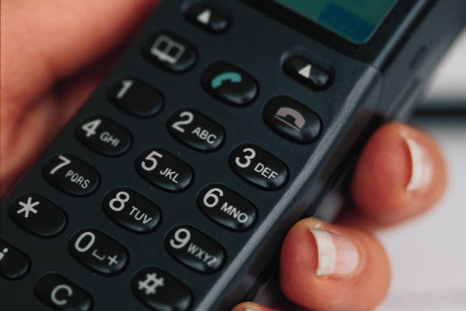
2-1-1
Dial 2-1-1 on your phone to get all the human services information for Lenawee County
This is a program brought to you by Lenawee United Way

Slide 28
Lcmha newsletter
“THE GRAPEVINE”
Contains all kinds of news;
articles and useful information
Advise Customer Services if you would like to receive a copy

Slide 29
Veggie Mobile calendar
Monday | Tuesday | Wednesday
9A-10A | 9A-10A | 9A-10A
Human Services Building | St. Alphonsus Church - Deerfield | Adrian Senior Center
10:30A-12:30P | 10:30A-11:30A | 12-1P
Riverview Terrace Apts. | Tecumseh Senior Center | Morenci Senior Center
 | 12-1P
 | Associated Charities

Slide 30
LENAWEE COMMUNITY MENTAL HEALTH AUTHORITY ANNUAL REPORT 2012
Board of Directors
Judy Ackley – Chairperson
Deb Bills – Vice Chair
Scott Clites – Secretary
Mark Jackson
Howard Keller
Emily Martinez
Greg Adams
Nate Smith
Comm. Cletus Smith
Jim Van Doren
Comm. Don Welch
Bob Wilson
Ask customer service for a copy

Slide 31
www.lcmha.org
All the information contained in this presentation is available from Customer Services or our website www.lcmha.org

Slide 32
“To effectively communicate, we must realize that we are all different in the way we perceive the world and use this understanding as a guide to our communication with others.”
–Anthony Robbins

Slide 33
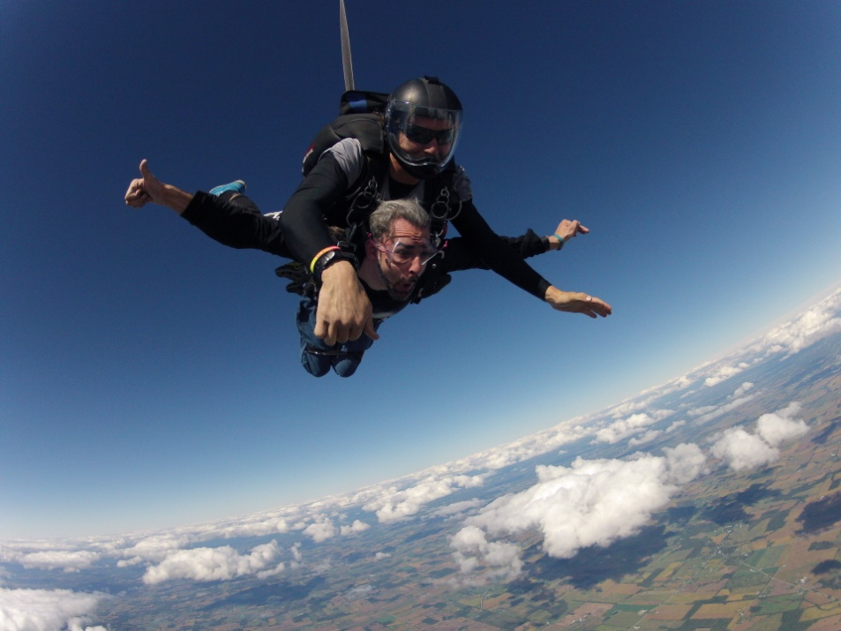
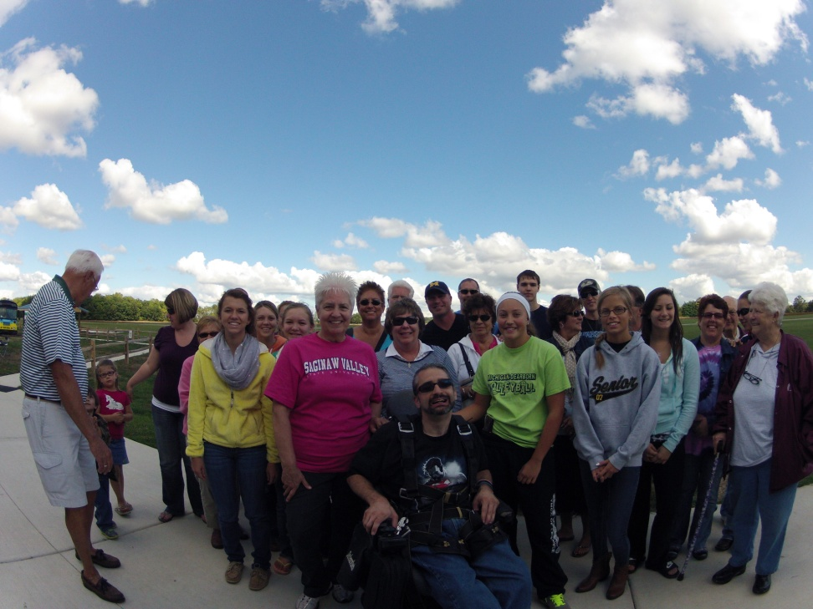
Tony’s “Flyboy” Jump
Look what
I did on
Sept 21 2013

Slide 34
Designed By:
Monitor Created by – Karen Rawlings
Monitor Updated by:
Tony Louden A.K.A.
Dudeonwheels
Tony “dudeonwheels” Louden
DON’T LET YOUR DISABILITY
DEFINE WHO YOU ARE

