Slide 1

WELCOME TO:
LENAWEE
COMMUNITY MENTAL HEALTH
AUTHORITY

Slide 2
MISSION STATEMENT
"Promoting Positive Outcomes
through Quality Mental Health Services."

Slide 3

LCMHA is a member of The Community Mental Health Partnership of Southeastern Michigan
Along with Livingston, Monroe and Washtenaw County
This partnership strives to be the model of excellence in a regional system of integrated care, joining with consumers, families and the community to help consumers reach their dreams

Slide 4

ACCREDITATION
LCMHA is accredited by The Joint Commission of Healthcare Organizations
If someone you know has an issue with their services or feels unsafe:
Contact Customer Services
263.8905

Slide 5
YOUR RIGHTS
All consumers of Lenawee Community Mental Health will be treated fairly and with dignity and respect.
If this is not happening, contact
  The Recipient Rights Officer –Fran Foley
  ask for a Recipient Rights Complaint Form
  ask for Customer Services

Slide 6
WHAT IS CUSTOMER SERVICES?
A link between you, the CMH System and the community
Seeks to reduce stigma about disabilities by educating the public
Wants you to be satisfied with the services you receive
Answers any questions you may have about mental health issues

Slide 7
CONTACT US
Lenawee Community Mental Health Authority
1040 S. Winter Street, Suite 1022
Adrian, MI 49221
Phone: (517) 263-8905
Toll Free: (800) 664-5005
Hours: Mon. thru Fri. 8:30 a.m. – 5:00 p.m.
Evening hours by appointment

Slide 8
HELP REDUCE STIGMA
Become a member of the:
MENTAL HEALTH AWARENESS COMMITTEE
Help organize conferences/workshops
Arrange programs for the community
Learn how to be a leader, to express your thoughts
Call Customer Services at 263-8905

Slide 9
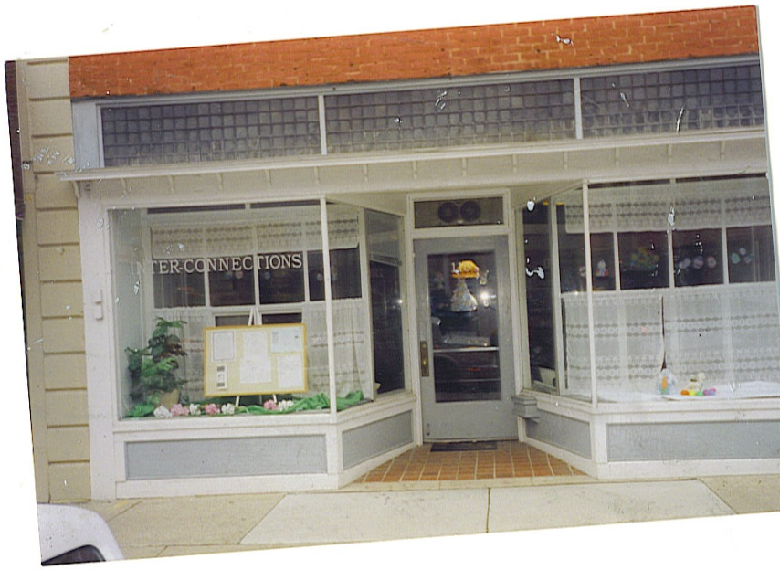
INTERCONNECTIONS
DROP IN CENTER
A place where persons with mental illness can come together to connect with each other in a social setting
110 W. Maumee Street
Adrian, MI 49221
517.265.9588
HOURS
Closed Sundays
Mon, Tues, Wed 12 – 5pm
Thurs – Sat 12pm – 8pm
www.lcmha.org – go to InterConnections

Slide 10
PEER SUPPORT SPECIALISTS
A Certified Peer Support Specialist is a person in recovery who is certified to help people on their journey of recovery
What can a Peer Support Specialist do?
Answer benefit/service questions
Give you info about community resources
Be a listening ear when one is needed
If you would like to talk with a Certified Peer Support Specialist, call 517.263.8905

Slide 11
LENAWEE PEER SPECIALISTS
Brenda Lawson – LCMHA (263.8905)
Mark Roman – Inter-Connections
(265.9588)
Jennifer Stidham - Inter-Connections (265.9588)

Slide 12
COMMUNITY RESOURCES
Are you in need of housing?
Do you know of someone who needs help with their utilities?
Do you need other information?
Ask Customer Services for a list of resources

Slide 13
NO PRIMARY CARE DOCTOR?
OR NO INSURANCE?
Contact:
The Family Medical Center
225 Riverside Avenue, Adrian, MI 49221
517.263.1800

Slide 14
NO PRESCRIPTION DRUG COVERAGE?
Ask the nurse about the Patient Assistance Program
or
The Familywize discount prescription card

Slide 15
PRO-MEDICA
2011 CHARITABLE CARE
Financial options available for low-income families and those without medical insurance at Bixby Medical Center in Adrian, and Herrick Medical Center in Tecumseh.
To determine eligibility for reduced or free health services – ask for a copy of their report from Customer Services.

Slide 16

SUICIDE PREVENTION
Thoughts of Suicide?
Crisis hotlines are available at:
1-800-273-8255
or
1-800-784-2433

Slide 17

HELPLINE ESPANOL
¿No te alcanza el dinero para comprar comida para ti y tu familia?
…no te preocupes
Llámanos a la Línea de Ayuda para el Programa de Alimentos y Nutrición
1-800- 481-4989 www.foodstamphelp.org
Te diremos si calificas para recibir una Tarjeta de Asistencia de Comida o Bridge Card.
Nuestros servicios son gratis, la llamada es confidencial y puede ser en Español o Ingles.
Michigan State University (MSUE) trabaja con la Línea de Ayuda para darte información de cómo:
Comprar más alimentos con menos dinero.
Preparar comidas fáciles y saludables para ti y tu familia.

Slide 18

HELPLINE
Is your plate empty?
Call the Food and Nutrition Helpline at
1-800-481-4989
M-F 9am-5pm
www.foodstamphelp.org

Slide 19
LENAWEE RICC
You’re invited to get involved
Come to a RICC meeting!
for information: Call Scott Watson
at 517-265-2410
Visit our website: http://www.orgsites.com/mi/lenaweericc/

Slide 20
DEPRESSION
SUPPORT GROUP
Wednesdays
2:00pm – 3:00pm
Interconnections Drop In Center
110 W. Maumee St, Adrian
No Cost
Call: 265.9588
or
263.8905
Customer Services for more information

Slide 21
LOCAL SUPPORT GROUPS
Schizophrenia Anonymous (SA)
Wednesday 3:00 – 4:00 pm
Depression and Bi-Polar Alliance (DBSA)
Thursdays 3:00 – 4:00 pm
Call 265-9588 for more info.

Slide 22
PROGRAMS FOR HOMELESS
Homeless Assistance Recovery Program (HARP):
Section 8 vouchers for homeless families and individuals
To apply call 265-6776 Kelli Kamm
Tenant Based Rental Assistance (TBRA):
A program to provide housing for young families
To apply call 264-0782 or go to LEAHC

Slide 23

2-1-1
Dial 2-1-1 on your phone to get all the human services information for Lenawee County
This is a program brought to you by Lenawee United Way

Slide 24
Lcmha newsletter
“THE GRAPEVINE”
Contains all kinds of news;
articles and useful information
Advise Customer Services if you would like to receive a copy

Slide 25

When: Wednesday, January 25; 10 am – 3 pm
Where: River Raisin Room
Human Services Bldg. Adrian
individuals and families who are homeless, or
in housing crisis
focus on linking with/getting immediate services
Free/open to everyone who wants to learn about homeless resources in our County.
Resources will include:
* Housing * Free Blankets and other items
* Employment and Job Training Information
* Hot meal * Health Related Testing and Education
* Guidance with Applications for Assistance and much more
Transportation is available!
For more information, please call Melinda at 264-0782
or Gay at 265-6776.

Slide 26
www.lcmha.org
All the information contained in this presentation is available from Customer Services or our website www.lcmha.org

